Slide 1

Ageless Workplaces Innovation Grant
National Innovation Challenge on Active and Confident Ageing
Public Briefing
26 May 2016

Slide 2
Programme
National Innovation Challenge on Active and Confident Ageing
Ageless Workplaces Innovation Grant
  Challenge Statement
  Examples of Projects
  Eligibility
  Project Team Composition
  Funding
  Project Phases
  Application Process
  KPIs
  Broad Evaluation Criteria
  Timeline
Q&A

Slide 3

National Innovation Challenge on
Active and Confident Ageing
The National Innovation Challenge (NIC) on Active and Confident Ageing was announced by Minister for Health and Chairman of the Ministerial Committee on Ageing as part of the Action Plan for Successful Ageing on 26 August 2015
This NIC seeks to catalyse innovative ideas and research in Singapore that can transform the experience of ageing in Singapore, tomorrow.

Slide 4
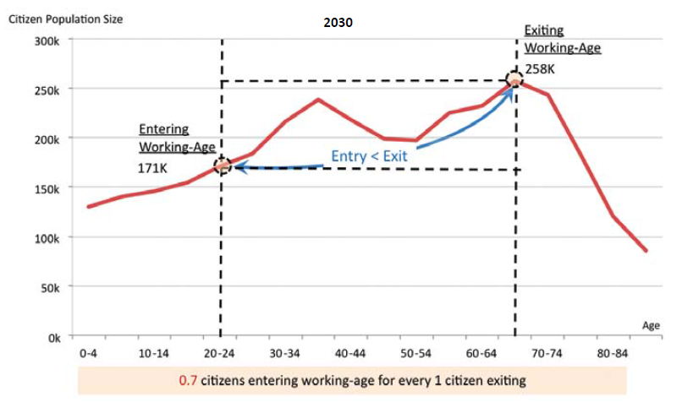
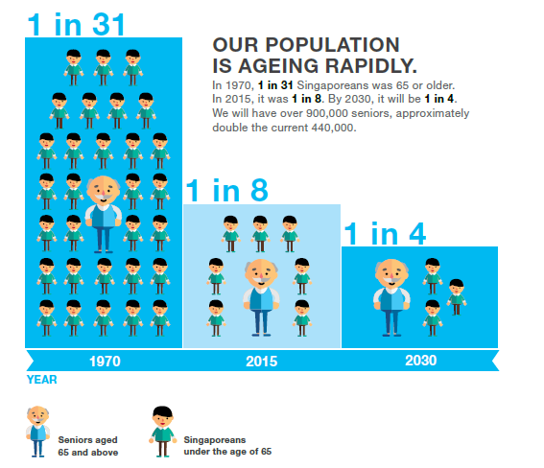
Singapore is ageing rapidly
By 2030, there will be over 900,000 Singaporean seniors
Source: Population White Paper,
Jan 2013.

Slide 5
Ageless Workplaces Innovation Grant
  This is our third grant call, under the NIC thrust on “Productive Longevity”
  We seek novel, practical and impactful game-changing solutions that may include (a) new inventions in automation or labour-augmenting devices or (b) significant trial of age management systems that have never been trialled at scale locally before.
  Two objectives for the Ageless Workplaces Innovation Grant
    Improve the productivity and health of older workers
    Enable older workers to be employable for as long as possible, beyond 65 years old

Slide 6
Challenge Statement
Participants can explore ideas (i) across sectors or (ii) focus on a sector specific solution.
Projects should look into ways to transform the workplace into an ‘ageless workplace’ that can enable a 50% improvement in the productivity of older workers aged 65 years and above and/or increase the employment of workers aged 65 years and above by 50% or more, both compared to sector and company specific benchmarks, whichever is higher.

Slide 7
Examples of Projects
Robotics and Assistive Technology
Workstation re-design, with automation, to reduce physical demand and improve comfort and safety for older workers
Use of assistive technology to augment labour productivity
Age management practices
Study of the optimal lifespan of certain job types and how older workers reaching the end of the optimal job lifespan can be rotated to new positions or a re-designed job scope that allows them to continue tapping on their accumulated experience
Flexible work arrangements such as reduced work hours, telework or project-based work.

Slide 8
Eligibility
Participants forming Project Teams can submit more than one Grant Proposal in response to the challenge statement but a Project Team will only be awarded Funding for one Project.
Open to all public, private or non-profit organisations, research institutes and institutes of higher learning, registered and/or incorporated in Singapore.
There are no restrictions on nationality for individuals, but the entity they represent must be registered in Singapore either through the setting up of a local equivalent of the entity in Singapore or through a consortium with Singapore-registered entities.
Project teams are to identify a ‘Host Organisation’ for the administration of the Project.

Slide 9
Project Team Composition
Required to partner an implementation partner and form a Project Team comprising:
  Members from multi-disciplinary (e.g. pairing medical and technology, engineering) background and/or involving more than one organisation; and
  An implementation partner that is a company with at least 200 staff.
No restriction on the number of Participants in each Project Team
Participants are expected to form their own partnerships.
List of potential partners will be available on the Ageless Workplaces Innovation Grant website by mid June 2016.

Slide 10
Project Funding
Awardees may qualify for up to 80% funding of approved qualifying costs to develop and implement their Project for a period of up to 3 years, with the possibility of extension for another 1 year.
Qualifying costs include both developmental and operating costs
Project Teams are expected to co-fund the remaining 20% of qualifying costs
Support for indirect costs, on top of supportable qualifying costs, is capped at 20% of the supportable qualifying direct costs
Funding will be provided in phases and subjected to the successful attainment of milestones and Key Performance Indicators (KPIs) tied to each phase

Slide 11
Explanation of Costs
In general, qualifying costs are direct costs that are required to execute or implement the Project, and are held accountable to the performance of the particular Project. These include,
  Expenditure on manpower (EOM);
  Expenditure on new equipment; and
  Other operating expenses (OOE)
Indirect costs are are those that are incurred for common or joint objectives and therefore cannot be identified readily and specifically with a particular Project, but contribute to the ability of the Host Organisation to support Projects. Examples include,
  General administration and general expenses (eg. provision of research space)
  Operation, maintenance and departmental administration expenses
  Library expenses, departmental administration expenses

Slide 12
Project Phases
Project teams will have the flexibility to decide the time allocated to the phases as follows,
Design phase (Proof-of-concept). Project teams are to articulate the concept of the programme / service / prototype and the process by which to achieve stated outcomes. Project teams should also provide studies and analyses that support the concept’s viability for further development.
Development phase (Proof-of-value). Project teams are to develop and validate the programme / service / prototype so that it takes on a clearer form to achieve the intended outcomes.
Implementation phase (Test-bedding) - At least one year. In this phase, project teams are to test and validate the programme / service / prototype in the field (a relevant environment). This phase may also include initial production or roll out.

Slide 13
Application Process
Proposals will be evaluated through a two-stage process
Project Abstract
  First, submit a short 5-page Proposal Abstract of the Project, including a comprehensive literature review that show the reasons for choosing a particular solution
  Project Teams are to use the “Project Abstract Submission Template” that can be downloaded from NMRC webpage
  Two hard copies of the Project Abstract and any supporting documents should reach MOH no later than 22 July 2016 at 5:00pm.
  Project Teams shall email soft copies to NIC_Ageing@moh.gov.sg by the deadline
Project Proposal
  Shortlisted proposals will then be invited to submit a detailed Project Proposal. This will be evaluated by an evaluation panel.

Slide 14
Project Abstract
Objective(s) of the Project;
Literature review and the evidence/basis for the Project;
Key components and innovations of the Project;
How the Project could address the challenge statement
Summary of the implementation plan, deployment plan, timelines and milestones of the Project; and
Summary of the evaluation framework and KPIs to track for the Project.

Slide 15
Additional Guidance (1)
Roles and Responsibilities
The roles and responsibilities of every Member of the Project Team must be clearly specified.
Proposed Solution(s)
To articulate in detail their proposed solution and how it can achieve the targeted outcomes/KPIs.
Project Teams will be expected to test-bed the proposed solution at the implementation phase if awarded the Grant.
Expected to ensure the safety and well-being of persons involved in any activity conducted in relation to the NIC is not compromised in any manner whatsoever.
Implementation Plan
Project Teams are required to describe all implementation activities, stages, Milestones and targets.

Slide 16
Additional Guidance (2)
Deployment Plan
Project Teams are required to include a detailed deployment plan as part of the Project Proposal to demonstrate scalability.
The deployment plan should discuss scaling of the proposed solution with at least 5 Singapore-based organisations within the targeted industry.
Deployment to the companies will not be funded under this Grant.
The 5 Singapore-based organisations must endorse the Project Proposal, but are not required to commit to the actual scaling of the solutions.

Slide 17
Mandatory KPIs (1)
Productivity
Project Teams should show a productivity improvement of 50% from the existing baseline applicable to the Implementation Partner
This is measured using output per older worker, which can be expressed in terms of physical quantities (e.g. numbers of customers served, number of books printed) or operational efficiency etc.

Slide 18
Mandatory KPIs (2)
Proportion of older workers aged 65 years and above in Implementation Partner
Project Teams should achieve more than 50% improvement from the existing baseline applicable to the Implementation Partner.
Table 1: Proportion of Older Workers Aged 65 Years and Above by Industry
Industry | Baseline Proportion of Older Workers Aged 65 Years and Above (%)
Overall (Across Sectors) | 5.4
Wholesale & Retail Trade | 5.5
Transportation & Storage | 7.0
Accommodation & Food Services | 11.1
Health & Social Services | 4.6

Slide 19
Mandatory KPIs (3)
Sustenance or improvement in function/physical health of older workers
Project Teams should show that the function or physical health of older workers are maintained or enhanced. Project Teams should consider the health issues relevant to the jobs or industries that the older workers are working in.

Slide 20
Other KPIs
Project Teams are to propose at least two other KPIs to track. Possible KPIs can include:
Reduction in exposure to work-related hazards or risks faced
Adaptability of solution (e.g. ease of use)
Improvement in attitudes of immediate supervisors and co-workers
Improvement in work motivations
Sustained work interests and job satisfaction

Slide 21
Broad Evaluation Criteria
Component | Evaluation Criteria
Grant Requirements | Proposal Abstract and Project Proposal Submission Locally-Based Project & Team Lead Project Team composition Addressed the challenge statement
General | Project Proposal submission Background of Team Lead Track record of Members of the Project Team and Implementation Partner(s)
Business | Scalability of proposed solution Sustainability of proposed solution Innovativeness of proposed solution
Performance | Proposed model/prototype/programme Proposed outcomes
Implementation | Project feasibility in the local context Clear implementation plans with demonstrable outcomes in field pilot stage Reasonableness of funding request and charges

Slide 22
Timeline
Activity | Date
Call for Grant Proposals | May 2016
Public Briefing | 26 May 2016 (Thurs)
Industry Networking | 10 June 2016 (Latest)
Deadline for Submission of Proposal Abstract | 22 July 2016 (Fri)
Deadline for Submission of Project Proposal | 30 September 2016 (Fri)
Announcement of Results | By December 2016

Slide 23
Industry Networking
Industry networking
There will be an industry networking session on 10 June 2016, 2:00pm at 60 Paya Lebar Road, #13-45, Paya Lebar Square Lobby 2, S(409051).
Participants who would like to attend and/or present their ideas during the industry networking session, please contact NIC(PO) at NIC_Ageing@moh.gov.sg by 3 June 2016, 5:00pm.
Note: Participants can work with any suitable company(s) and need not limit their partnerships to the companies listed on the e-marketplace.

Slide 24
Questions?
For enquiries, please email NIC_Ageing@moh.gov.sg

